Slide 1
Automatic street light control using 8051
Project Name :
Student Name : Suyog Jayavant Kale
Course Name : Microcontroller and Interfacing
Course Code : EX2404
Roll No . : 21151225
Branch Name : Second Year ENTC (EX-1)

Slide 2
Automatic street light control using 8051 :
Automatic street light control using 8051 microcontroller can be achieved by interfacing a light sensor with the microcontroller. The light sensor detects the amount of ambient light present and sends the signal to the microcontroller. The microcontroller then switches the street lights ON or OFF depending upon the ambient light level.
Here's a general idea of how this can be implemented:
Connect the light sensor to one of the input ports of the 8051 microcontroller.
Write a program to continuously monitor the input port connected to the light sensor.
Determine a threshold value for the ambient light level, below which the street lights should be switched ON.
When the ambient light level falls below the threshold value, the microcontroller should send a signal to switch ON the street lights. When the ambient light level rises above the threshold value, the microcontroller should send a signal to switch OFF the street lights.
Use a relay driver circuit to control the switching of the street lights.
Finally, test the circuit by varying the light levels and observe if the street lights turn ON and OFF accordingly.

Slide 3
Applications :
This project have many applications.
For example, you are too much lazy to turn on or turn off your street light manually and you forget to turn it on or off daily.
So you easily use this project to save your electricity and in return your money. In countries where load shedding is a big issue due to short fall in electricity and less in resources to generate electricity.
In these countries, load shedding issue can be resolved too some extent by saving as much as you can.
By using automatic control of street lights, we can save maximum amount of energy which is useful for your nation and also beneficial for you. Because it will reduce you electricity bill and in return save your money.

Slide 4
Circuit description :
Followings are the main components of automatic control of street lights :
Light sensor :
Light sensor is used to sense amount of light. There are many light sensors available in market but Light dependent resistor (LDR) is used as a light sensor. Because it is cheap in price, easily available in market and can be easily interfaced with microcontroller to sense intensity of light.
LDR have property to change its resistance according to intensity of light. If light is high, LDR will have low resistance and if light is low, LDR will have high resistance.
So microcontroller can easily read this resistance in the form of voltage and which can be back converted into proportional value of light by using a formula available in data sheet.I recommend you to have look in data sheet of LDR.
Relay interfacing with microcontroller :
Microcontroller is used to analyze intensity of light and to generate control signal which in turn on or off transistor which in turn energize relay to turn street light on or off.
NPN transistor is used as a switch and resistor at the base of transistor is used as current limiting resistor.

Slide 5
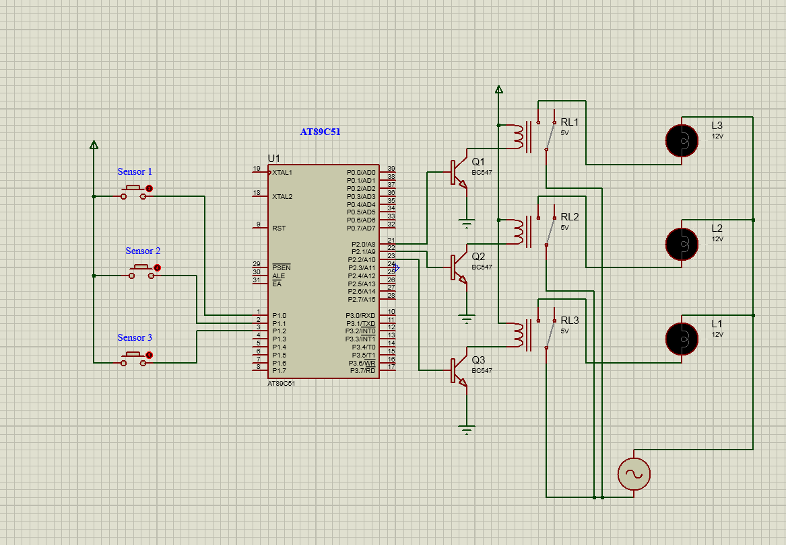
Proteus design :

Slide 6
Keil C Language Code :
CODE Starts Here :
#include<reg51.h>
sbit sensor1=P1^0;
sbit sensor2=P1^1;
sbit sensor3=P1^2;
sbit load1=P2^0;
sbit load2=P2^1;
sbit load3=P2^2;
void main ()
{
load1=load2=load3=0;
sensor1=sensor2=sensor3=0;
while(1) {
if(sensor1==1)
{ load1=1; load2=0; load3=0; }
if(sensor2==1)
{ load1=0; load2=1; load3=0; }
if(sensor3==1)
{ load1=0; load2=0; load3=1; } } }

Slide 7
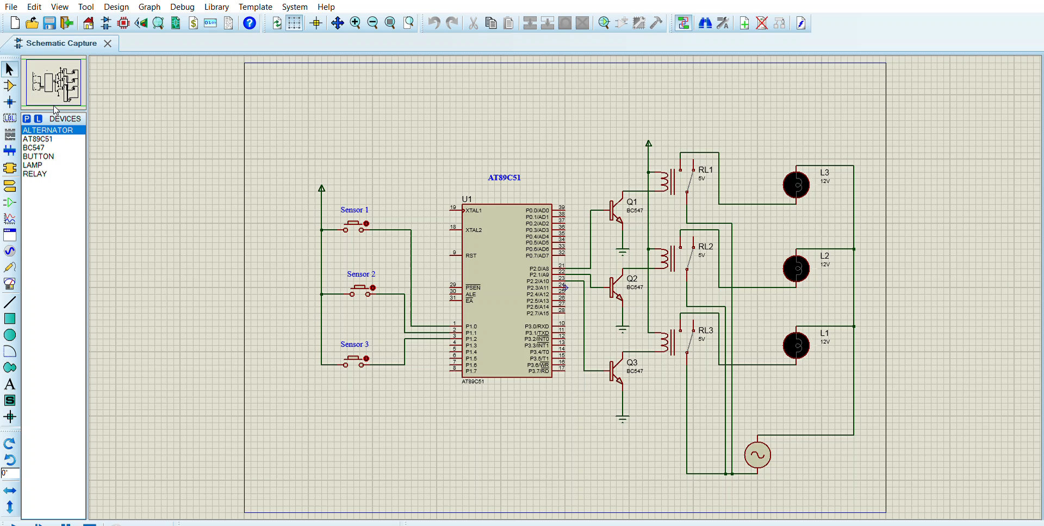
Project Simulation :

Slide 8
References :
https://youtu.be/mDQaGdNpDMA
https://microcontrollerslab.com/automatic-control-of-street-lights/
Thank You !!!

